Slide 1
How to delete physical item requests in batch
Yoel Kortick
Senior Librarian

Slide 2
Introduction
Examples before running job "Cancel physical items requests"
Run the job "Cancel physical items requests"
Examples after running job "Cancel physical items requests“
Do not cancel resource sharing (ILL) requests
Cancel only “Pickup from Shelf” requests

Slide 3
Introduction

Slide 4
Introduction
This presentation will explain how to use a physical item set to delete physical item requests.
In the first case we will use two examples:
A request which is not a resource sharing borrowing request.
A request which is a resource sharing borrowing request.
In the second case we will use two examples:
A request which is in status “pickup from shelf”.
A request which is on the active hold shelf.

Slide 5
Examples before running job "Cancel physical items requests"

Slide 6
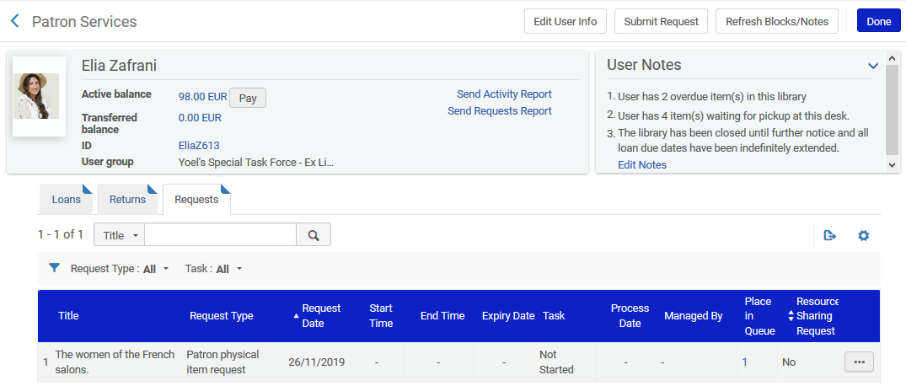
Examples before running job "Cancel physical items requests"
There is a patron physical item request for “Women of the French Salons”. It is not a resource sharing request.

Slide 7
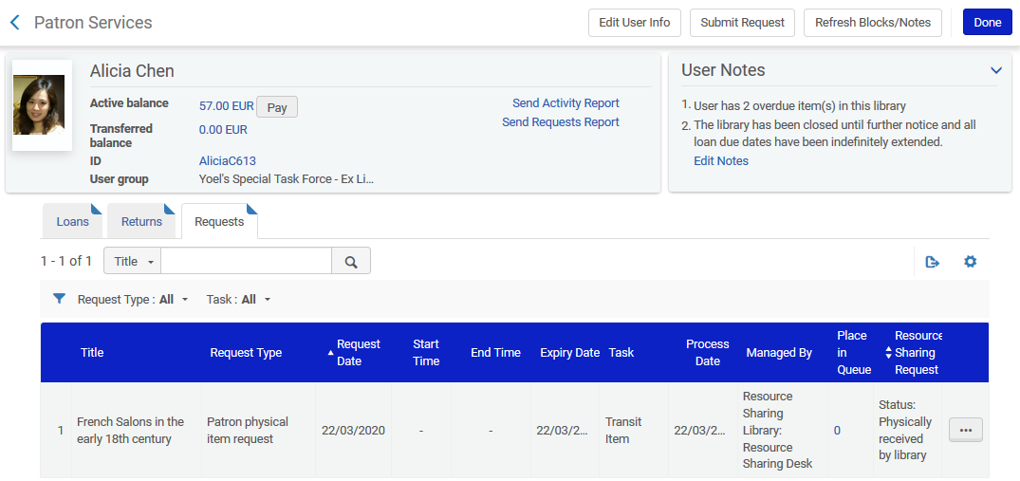
Examples before running job "Cancel physical items requests"
There is a patron physical item request for “French Salons in the early 18th century”. It is a resource sharing request.

Slide 8
Run the job "Cancel physical items requests"

Slide 9
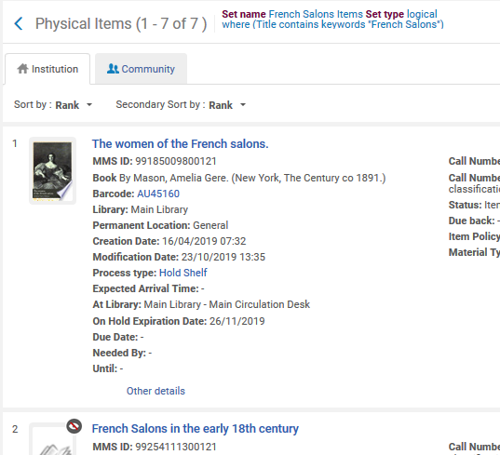
Run the job "Cancel physical items requests"
A physical item set with both items has been created, it is called “French Salons Items”

Slide 10
Run the job "Cancel physical items requests"
In the previous example we made a set of two items, in order to show for demonstrative purposes what happens to the requests.
There are several ways to create the physical item set and this would depend on your specific needs.

Slide 11
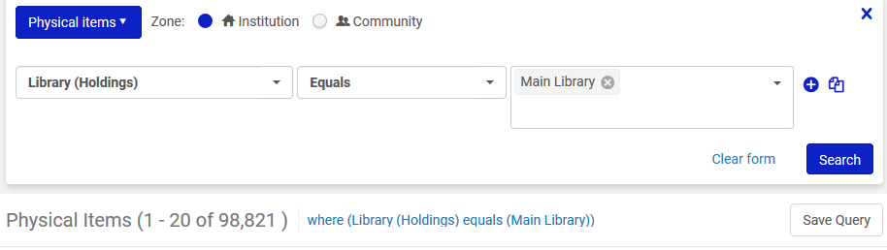
Run the job "Cancel physical items requests"
One way to create the set may be to search by library name in the physical items advanced search and then “save query”.

Slide 12
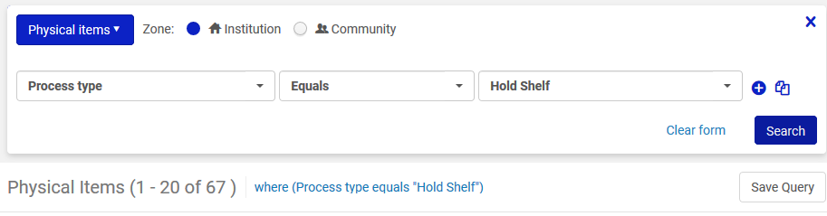
Run the job "Cancel physical items requests"
Another way to create the set may be to search by Process Type equals hold shelf in the physical items advanced search and then “save query”.

Slide 13
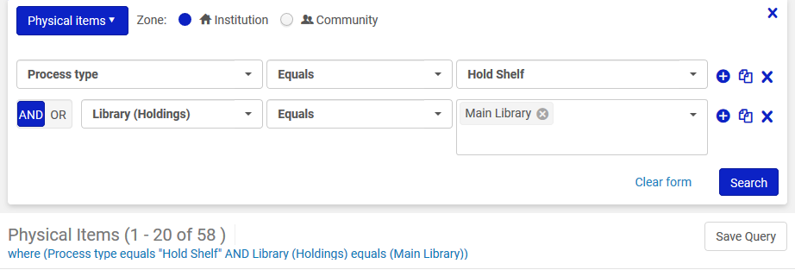
Run the job "Cancel physical items requests"
Another way to create the set may be to combine both previous searches into one set:
Search by Process Type equals hold shelf and library name in the physical items advanced search

Slide 14
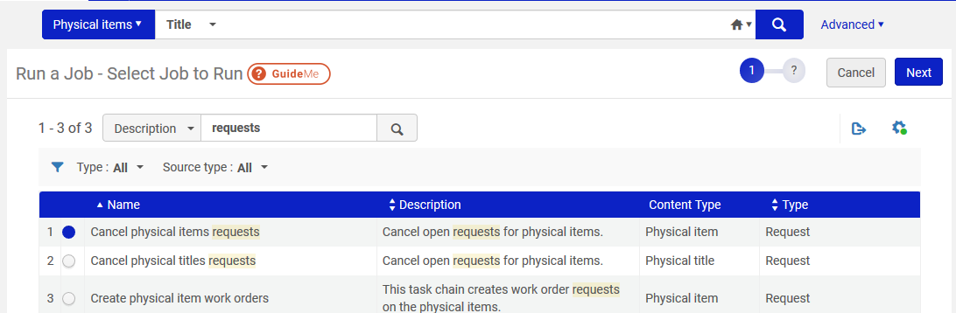
Run the job "Cancel physical items requests"
After the set is made: Via “Admin > Manage Jobs and Sets > Run a Job” we run the job “Cancel physical items requests”

Slide 15
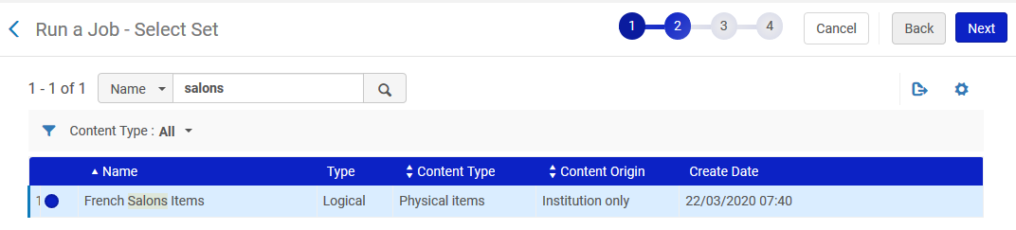
Run the job "Cancel physical items requests"
Choose the set with both of the items

Slide 16
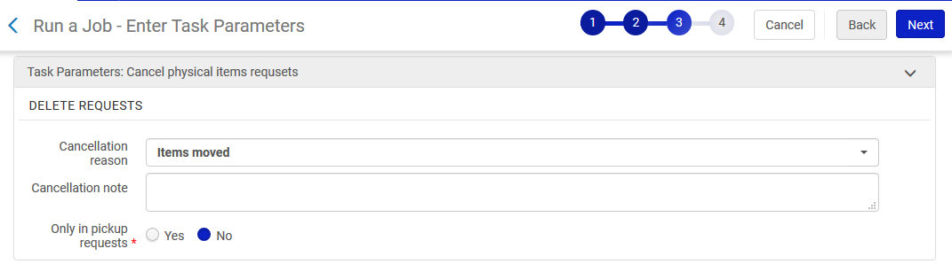
Run the job "Cancel physical items requests"
Run the job

Slide 17
Examples after running job "Cancel physical items requests"

Slide 18
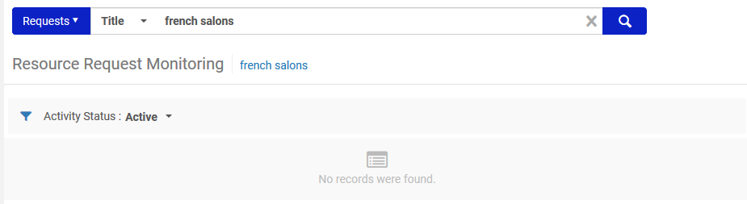
Examples after running job "Cancel physical items requests"
Both requests were removed

Slide 19
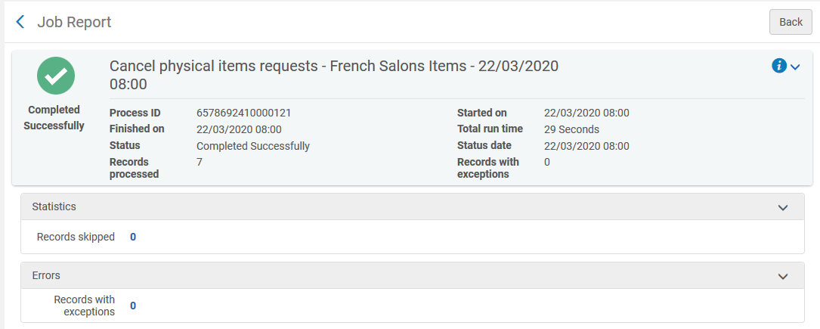
Examples after running job "Cancel physical items requests"
We also see from the job report that all items in the set had the request removed

Slide 20
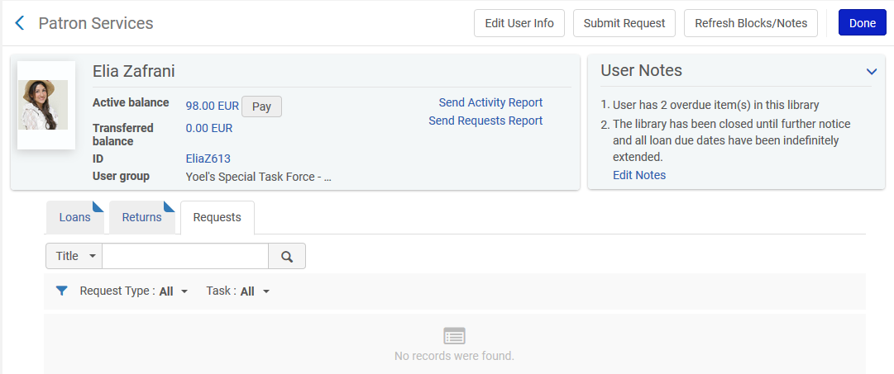
Examples after running job "Cancel physical items requests"
The patrons who had the request no longer have it

Slide 21
Do not cancel resource sharing (ILL) requests

Slide 22
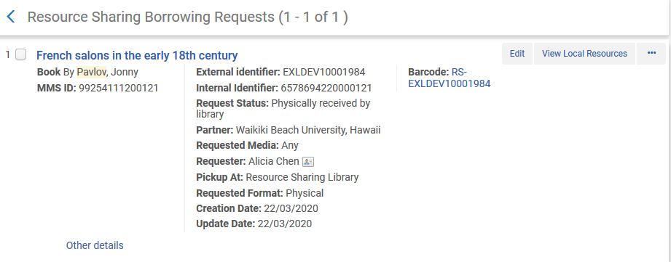
Do not cancel resource sharing (ILL) requests
Here is a resource sharing borrowing request

Slide 23
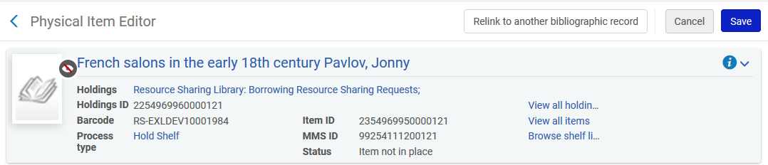
Do not cancel resource sharing (ILL) requests
The item is in the “Resource Sharing Library”, in the location “Borrowing Resource Sharing Requests”

Slide 24
Do not cancel resource sharing (ILL) requests
Therefore if we do not want to cancel Resource Sharing Requests when using the job “Cancel physical items requests” all we have to do is not include these in the set.
We can make the set as shown on the following slide.
In the advanced search for physical items we state “Permanent Physical Location (Holdings) does not equal “Resource Sharing Library” location “Borrowing Resource Sharing Requests”

Slide 25
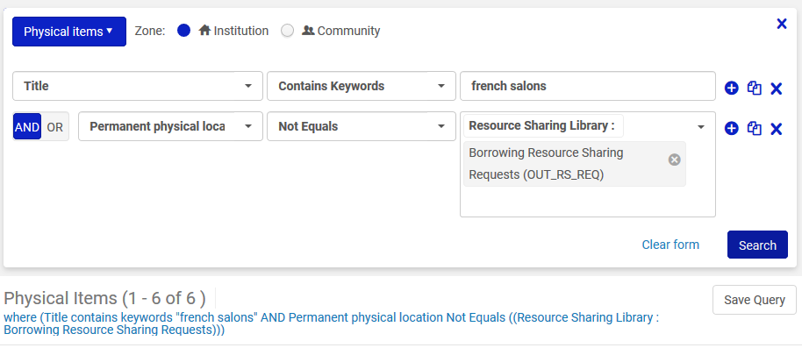
Do not cancel resource sharing (ILL) requests

Slide 26
Cancel only “Pickup from Shelf” requests

Slide 27
Cancel only “Pickup from Shelf” requests
In the example here:
Jazz for Dummies has a request with status “Pickup from Shelf”
Feminism and renaissance studies has a request on the active hold shelf
Both items will be in a set but we want to only to cancel the request for “Jazz for Dummies” because it has status “Pickup from Shelf”

Slide 28
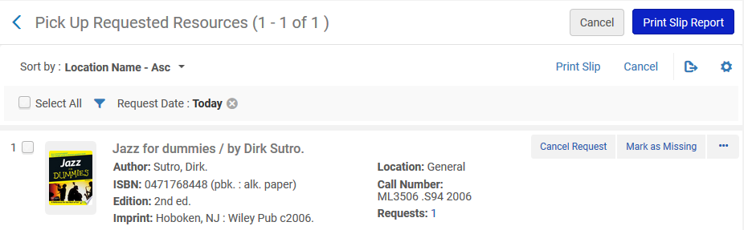
Cancel only “Pickup from Shelf” requests
Jazz for Dummies has a request with status “Pickup from Shelf”

Slide 29
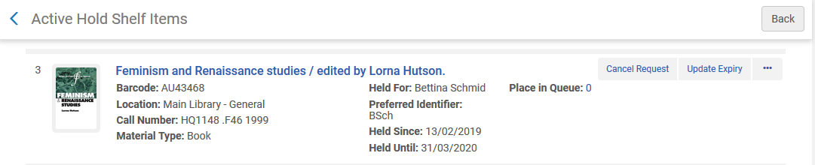
Cancel only “Pickup from Shelf” requests
Feminism and renaissance studies has a request on the active hold shelf

Slide 30
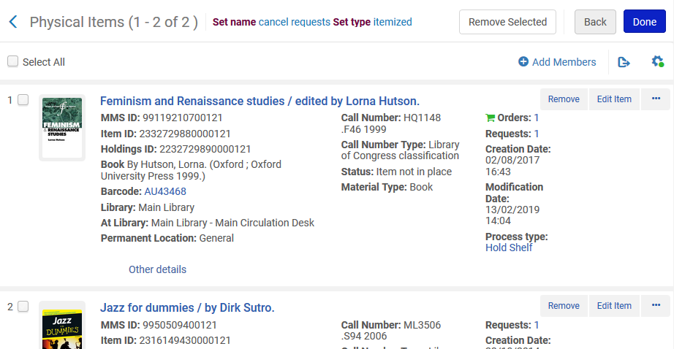
Cancel only “Pickup from Shelf” requests
Both items are in set “cancel requests”

Slide 31
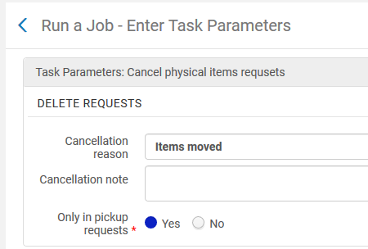
Cancel only “Pickup from Shelf” requests
We run the job “Cancel physical items requests” on this set and we choose “Only in pickup requests” = Yes

Slide 32
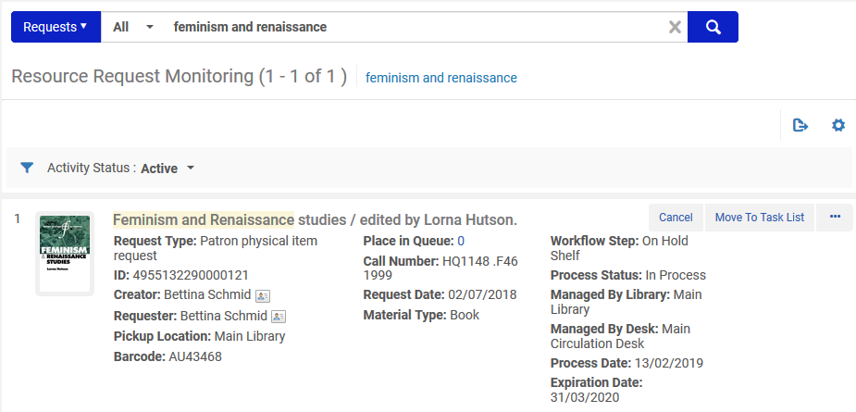
Cancel only “Pickup from Shelf” requests
Feminism and Renaissance Studies still has a hold request. It was not canceled

Slide 33
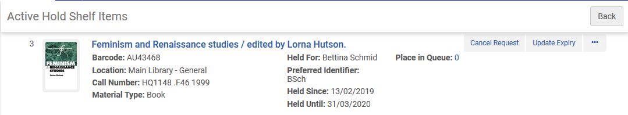
Cancel only “Pickup from Shelf” requests
Feminism and Renaissance Studies is still on the Active Hold Shelf. It was not canceled.

Slide 34
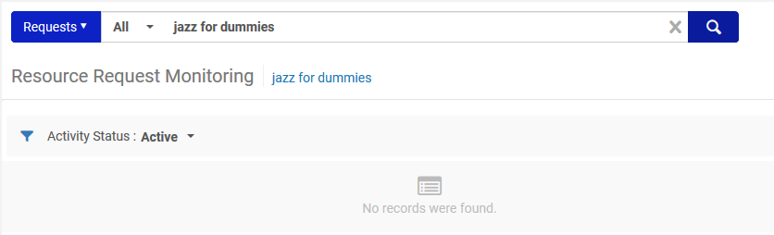
Cancel only “Pickup from Shelf” requests
The request for “Jazz for Dummies” has been canceled

Slide 35
Thank you!
xxx@exlibrisgroup.com

